Slide 1

Segmented Customer Buying Habits Analysis
Analysis and conclusions by
Thanos Chronopoulos
Andreas Gabriel
Filippos Georgiopoulos

Slide 2
Executive Summary
The analysis focused on two key pylons for our customer clustering
Pylon 1:
Strategic Macro-Segmentation (2-Cluster Model)
Primary Focus: The fundamental market divide
Business Utility: Brand Positioning & Strategy
Key Metric: Demographic & Category Gravity
Pylon 2:
Tactical Micro-Persona Analysis (4-Cluster Model)
Primary Focus: The Granular Buying Habits
Business Utility: Targeted Execution & Personalization
Key Metric: Frequency, Rating, & Purchase Logic

Slide 3
Pylon 1: Strategic Macro-Segmentation (2-Cluster Model)

Slide 4
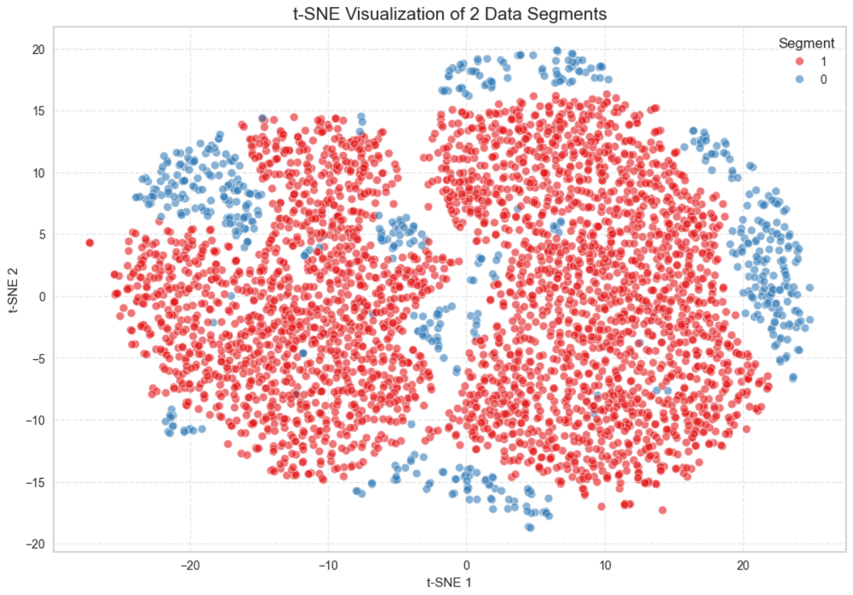
Two primary customer segments

Slide 5
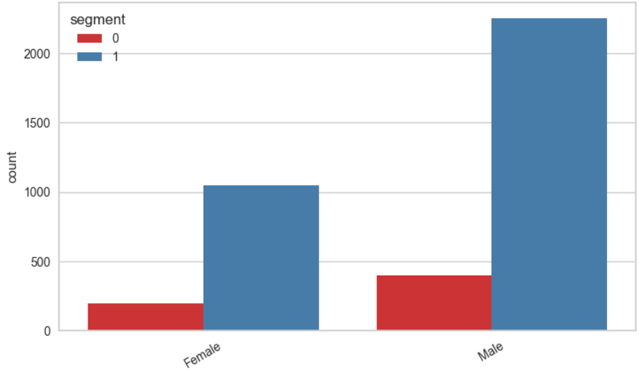
The Gender Split

Slide 6
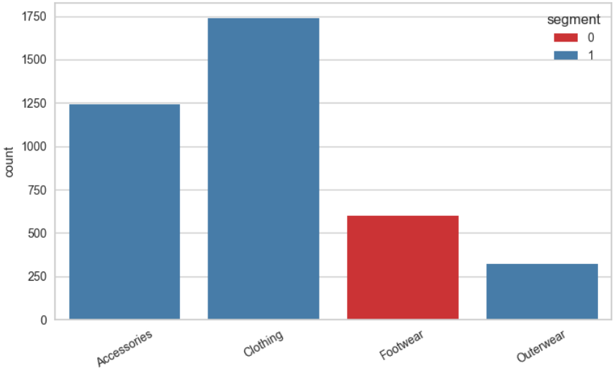
Category Preferences

Slide 7
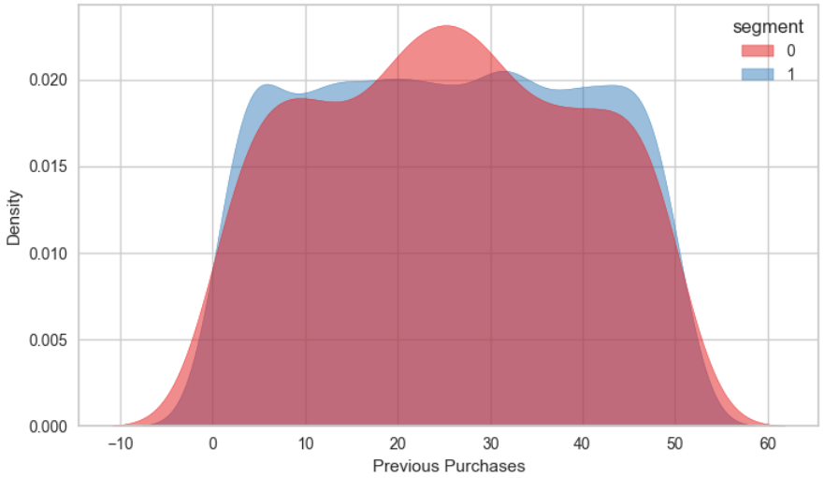
Amount of Previous Purchases

Slide 8
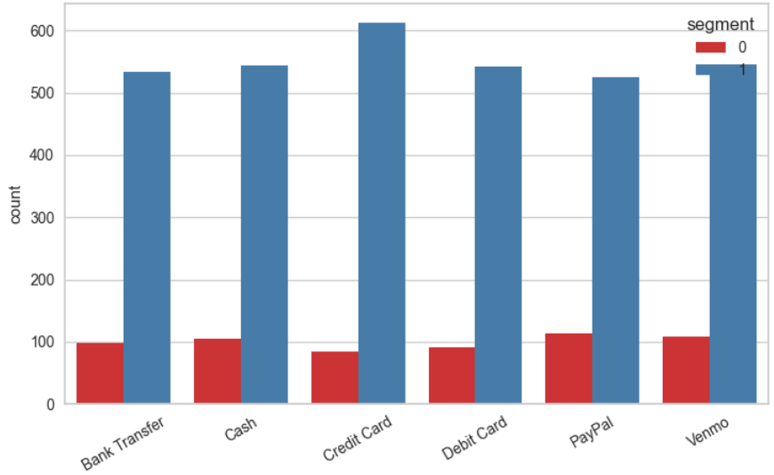
Payment Method

Slide 9
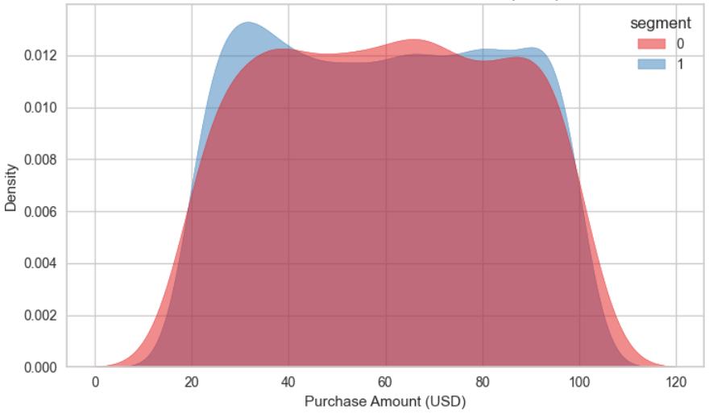
Distribution of Purchase Amount

Slide 10
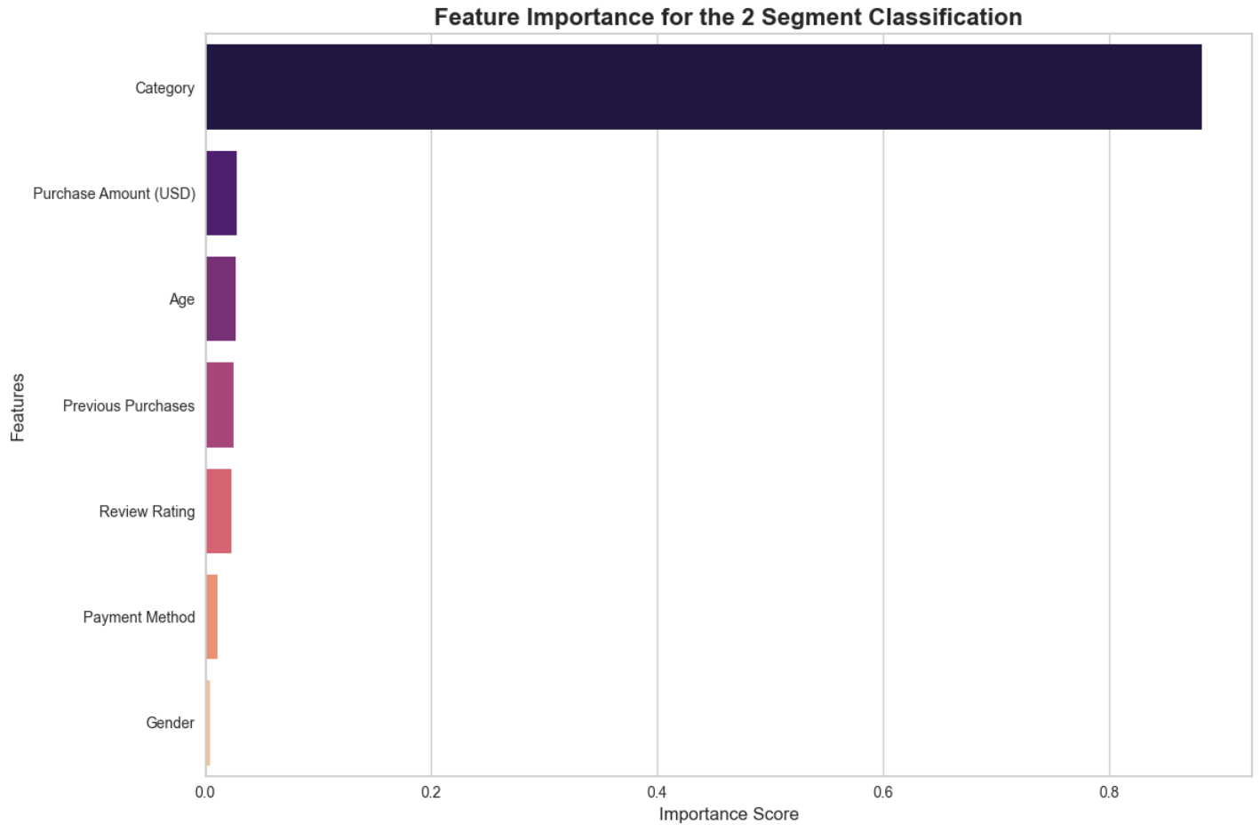
Main drivers for the clusters

Slide 11
Conclusion: The "Mass Market" vs. "Footwear Specialist" Split
The dataset is dominated by one massive, diverse group, with a much smaller secondary group defined by a very specific product interest.
Segment 0 (The Footwear Specialist): A much smaller, niche group containing only a fraction of both male and female shoppers. This segment is defined almost exclusively by their focus on Footwear.
Segment 1 (Mass Market): This is a high-volume, Gender-Neutral cluster. It contains nearly all female shoppers and the vast majority of males. This group is primarily interested in Clothing and Accessories.
Strategic Pivot: Prioritize broad-reach Apparel and Lifestyle campaigns for the Mass Market (Segment 1), while creating a highly targeted "Footwear Specialist" track for Segment 0.
Next Steps: Transitioning to the 4-Cluster Model
By moving from 2 to 4 clusters, we will "shatter" these large blocks—specifically the blended Segment 1—to identify "High-Value VIPs" hidden within the big groups.

Slide 12
Pylon 2: Tactical Micro-Persona Analysis (4-Cluster Model)

Slide 13
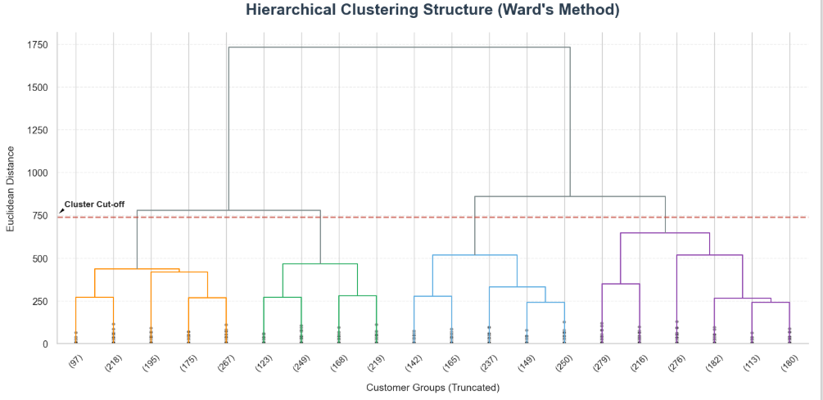
Four distinct customer sub-segments

Slide 14
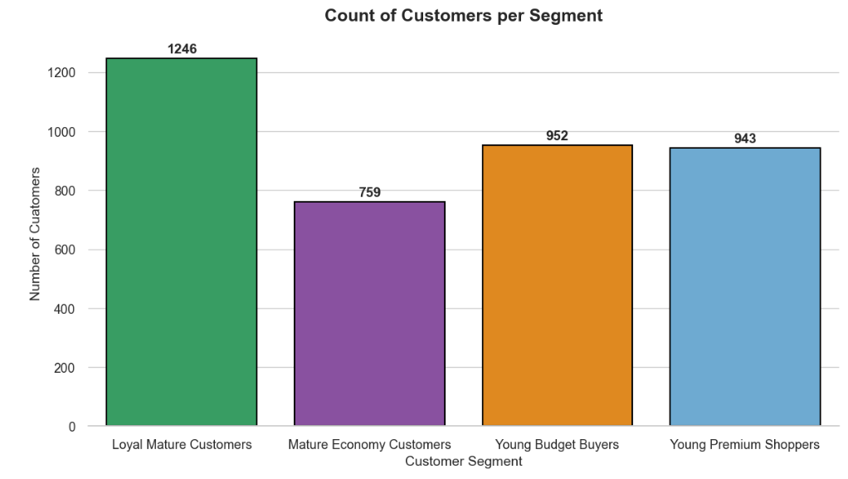
Customers Per Segment

Slide 15
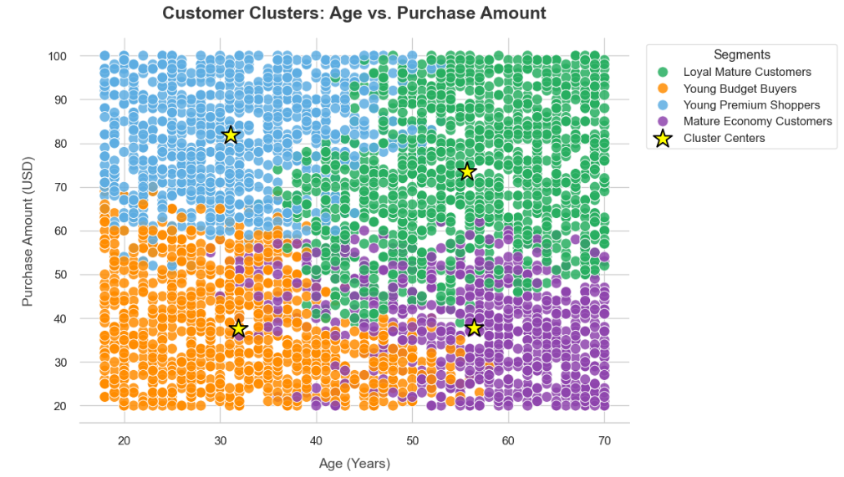
Age vs Purchase Amount

Slide 16
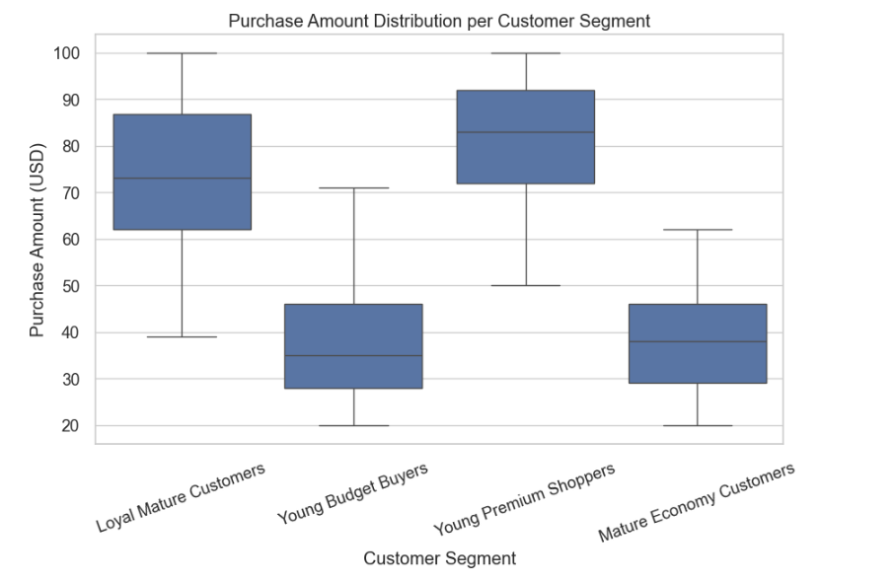
Purchase Amount Distribution

Slide 17
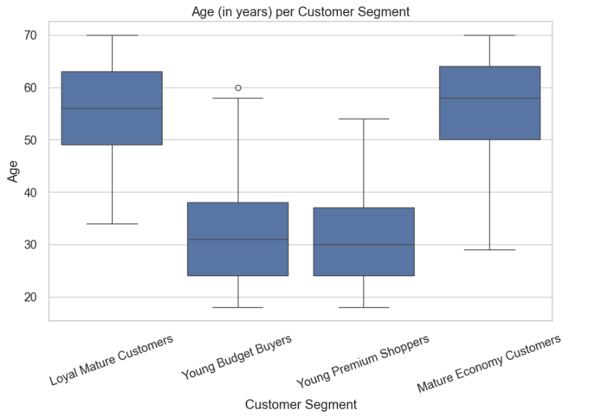
Age

Slide 18
Now let’s move on to the Power BI dashboard

